Slide 1
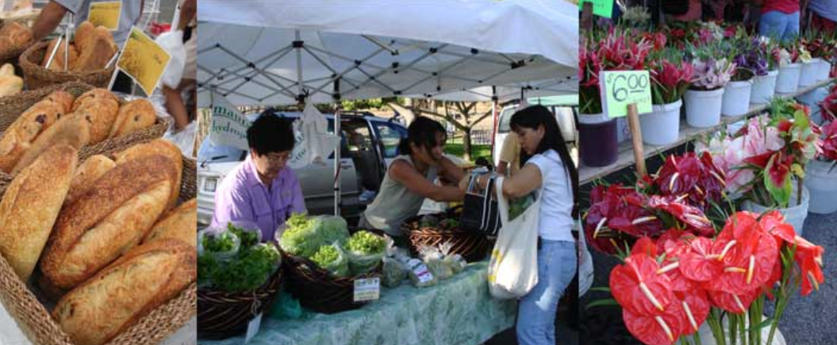
HAWAII’S FARMERS’ MARKET

Slide 2
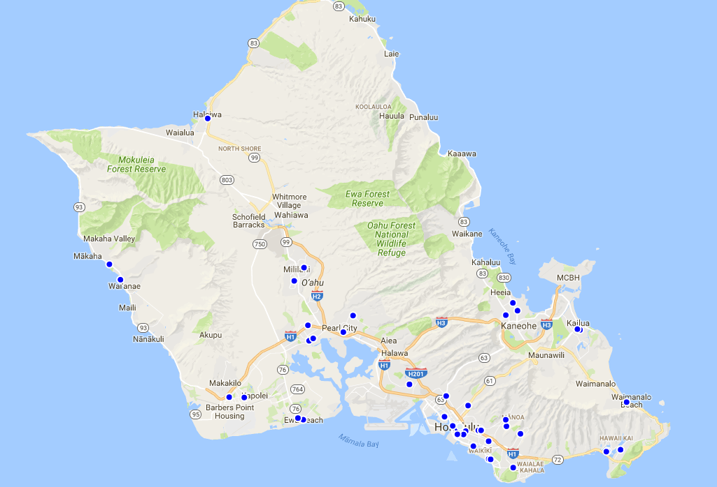
Over 200 estimated farmer’s market statewide. Over 70 here on Oahu.

Slide 3
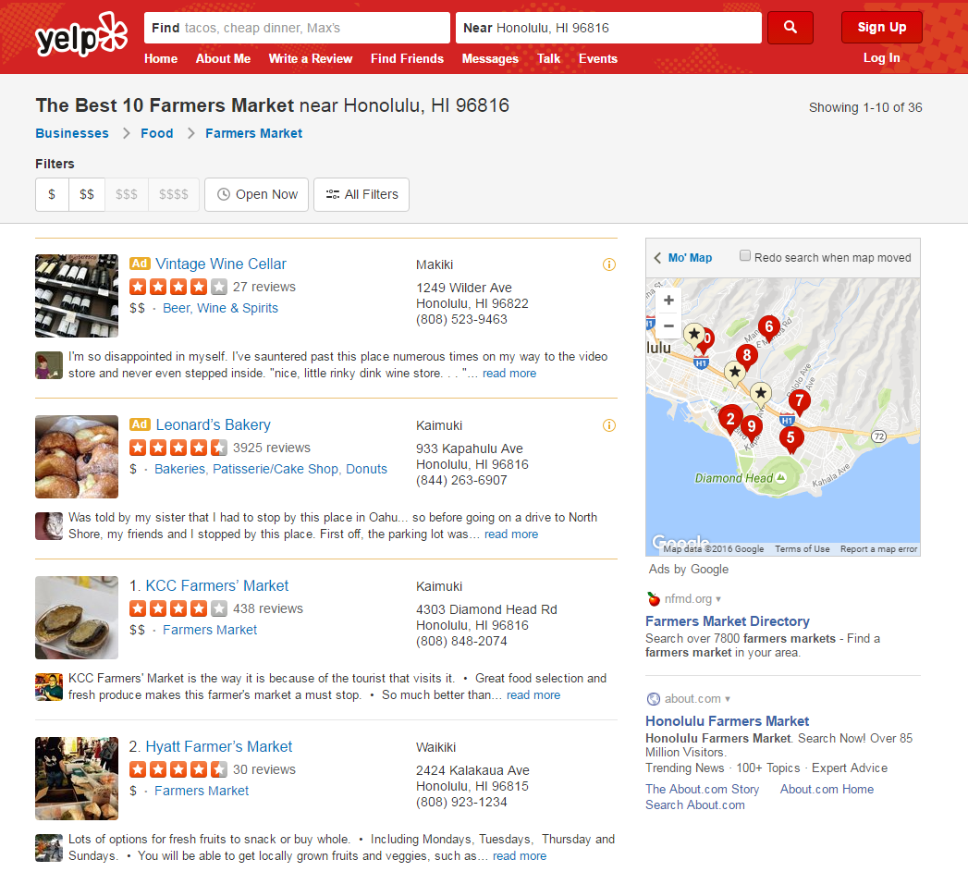
Where can you currently find your nearest farmer’s market?
Web searches provide links to organizers own websites, blog sites, visitor sites, etc.
Search on Yelp gave random results.
Not all have websites

Slide 4
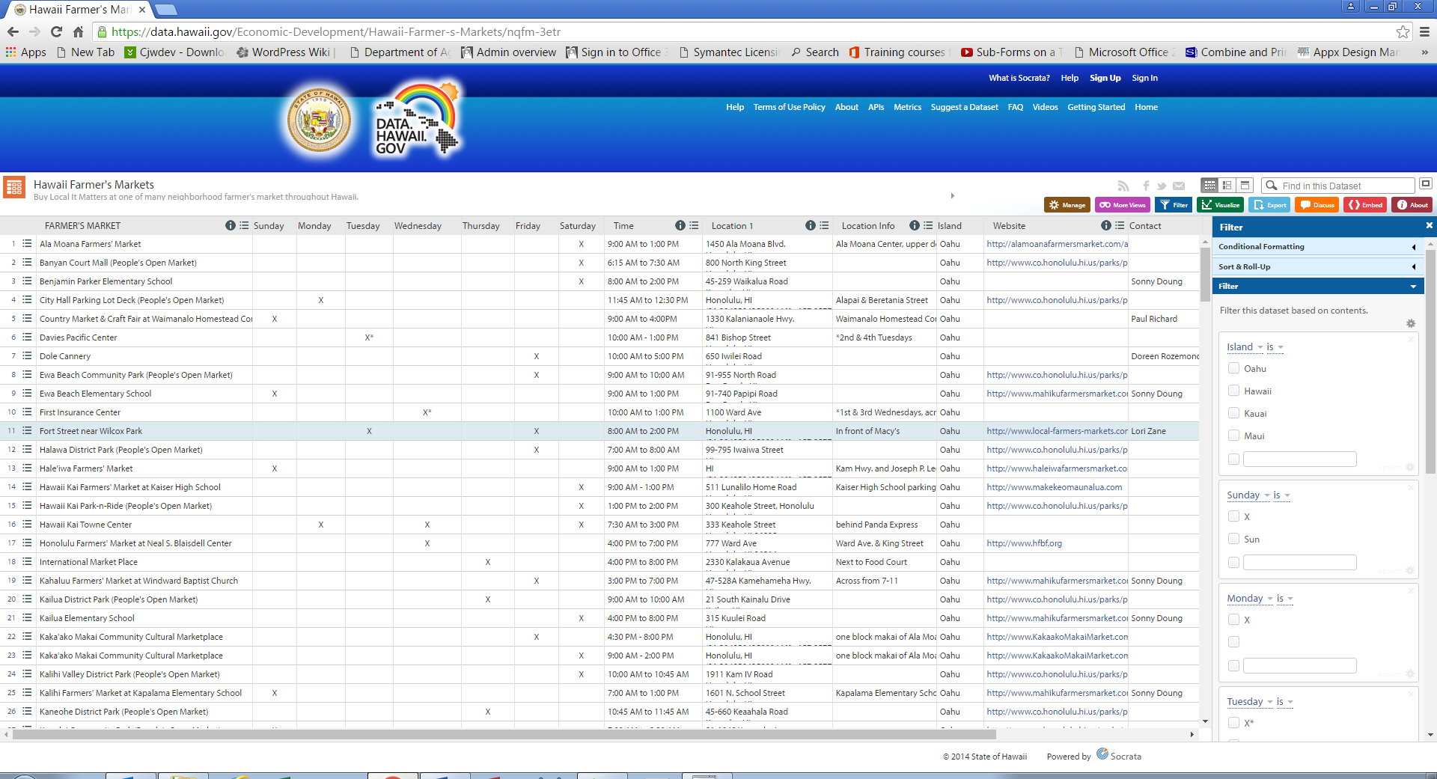
Where can you find your nearest farmer’s market?
HDOA has a statewide listing on data.hawaii.gov but it is out of date.
With markets popping up, relocating or closing, reduced staff was unable to keep up.

Slide 5
CHALLENGE GOAL
Engage public to go to Hawaii’s Farmers’ Markets
Provide Public with most current information
Reduce dependency on HDOA to keep information current
Support the Farmers’ Market organizers (big and small)
Support our local farmers and vendors

Slide 6

Challenge
Develop a mobile app where . . .
Farmers’ Market organizers can list/update their locations, dates, times, contact info, vendors and products
Post photos
List “What’s happening” or special events

Slide 7

Challenge
Develop a mobile app where . . .
Public can easily search for farmers’ markets depending on day of week, location, link to website, etc.
Public can search for a vendor or product
Click on map for more information
Allow public input (i.e. Comments, rate the farmers’ market ()

Slide 8

Challenge
Develop a mobile app where . . .
HDOA ability to easily contact organizers
HDOA ability to delete closed market records and/or user posting if necessary
Link to email: HDOA.MD@hawaii.gov

Slide 9
DATA AVAILABILITY
Sample available at ETS Hub or at data.hawaii.gov

Slide 10


Slide 11
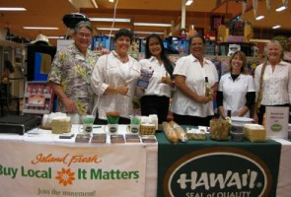
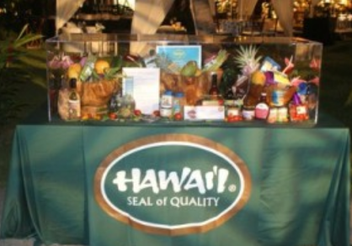
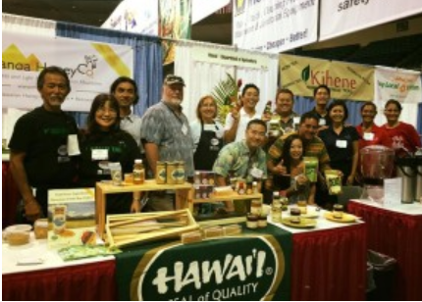
HAWAII AGRICULTURE FOOD & PRODUCTS

Slide 12
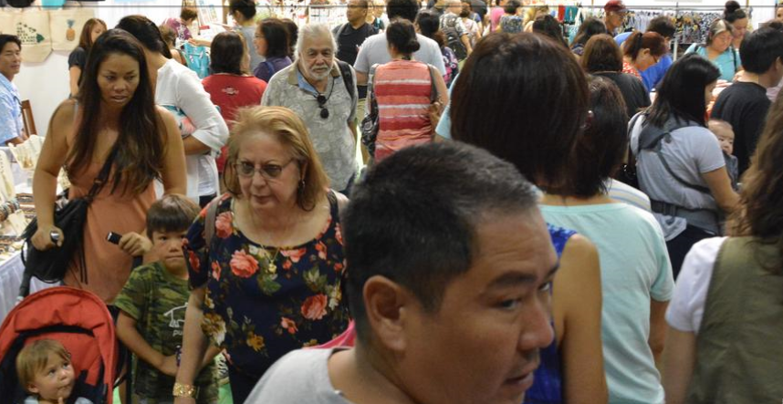

Demand for Hawaii Products by Locals
Over 400 vendors participated in the 2016 Made in Hawaii Festival
Over 45,000 people attended last year’s event
Popularity of Farmers’ markets increasing.
Local restaurants using local ingredients

Slide 13
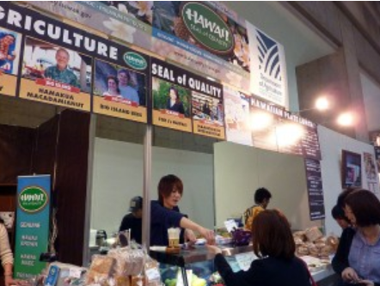
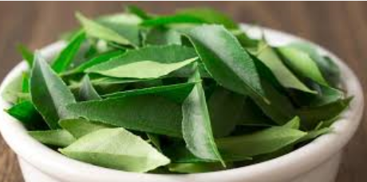
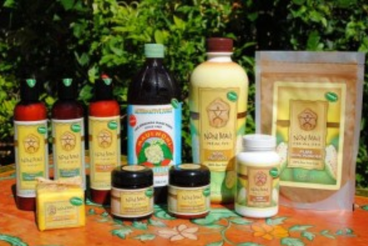
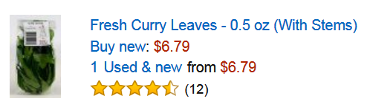
Hawaii Products Going Worldwide
Natural health products like Noni are requested
Trade shows spark interest in Hawaii products
Disasters in foreign countries have lead to requests for products

Slide 14
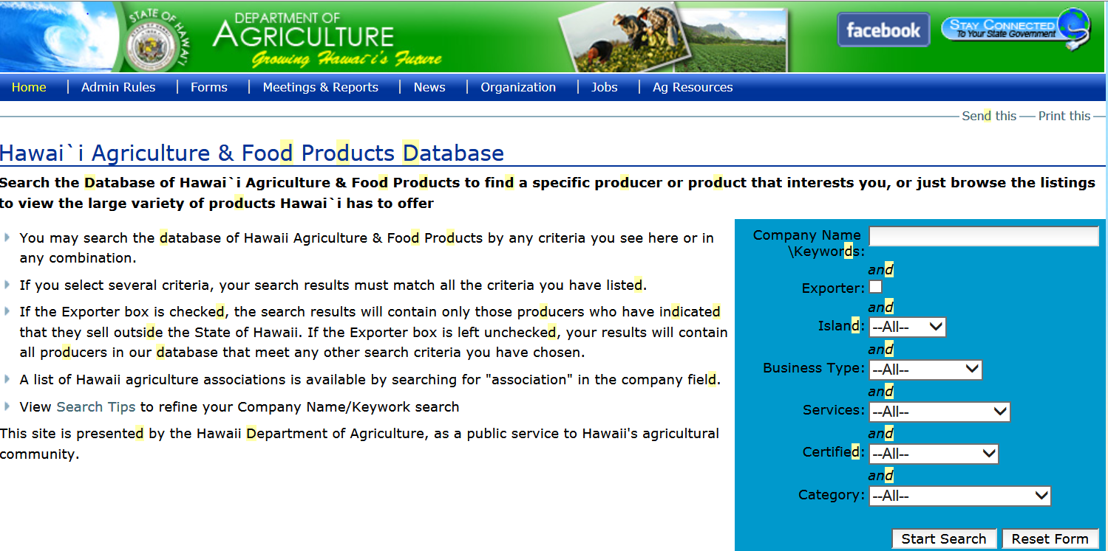
Previous database not supported on new website

Slide 15
Who qualifies as Hawaii Agriculture Food & Products
Companies licensed to do business in Hawaii offering Hawaii food & products.
Must be 100% grown or value-added products with at least 50% of inputs from Hawaii.

Slide 16

CHALLENGE GOAL
Grow Hawaii’s agriculture food and products industry by connecting local, national and international buyers to local companies.

Slide 17
Challenge
Develop an online app where . . .
Vendors can list/update their company information
Vendor can enter/update product information being sold (include Harmonized System Code if product sold internationally)
Vendors to enter/update products where products sold locally

Slide 18
Challenge
Develop an online app where . . .
Local, national and international buyers can search for Hawaii agriculture food & products and contact seller directly.
Buyers to generate email request to search result companies.
Buyers can do multiple searches (i.e. Certified Organic, papaya, sold on Oahu)
International buyers can search by product description or Harmonized System Code

Slide 19
Challenge
Develop an online app where . . .
HDOA to review submittals to verify qualification
HDOA ability to easily contact organizers
HDOA ability to delete closed business if necessary
Link to email: HDOA.MD@hawaii.gov

Slide 20
DATA AVAILABILITY
Data from the previous Hawaii Agriculture Food and Products database available at ETS hub in .csv format

Slide 21

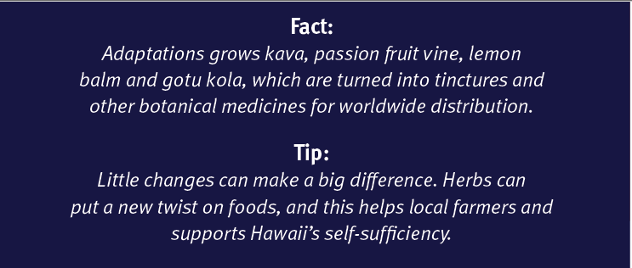
Help support Hawaii’s self-sufficiency
Tane Datta, Adaptations/Oceanfire
He transformed overgrown land on the slopes of Mauna Loa in Honaunau into a salad bowl. Everywhere you turn, you’ll find something delectable: kale, watermelon radishes, Swiss chard, fennel, asparagus, spearmint, opal basil, edible flowers and more.
Tane collaborates with the chefs of 70 hotels and restaurants statewide to raise what they need, while also making sure he and the other Hawai‘i Island farmers he distributes for can provide a stable supply of products at a fair price.

Slide 22
Help grow Hawaii’s agriculture food and products industry

